Slide 1
Updated slides for PAAW Project
Rakesh K. Kapania, Ph.D
Mitchell Professor of Aerospace and Ocean Engineering
Wei Zhao
Neeharika Muthirevula
Rikin Gupta
Mohamed Jrad
July 30, 2015
Multidisciplinary Analysis and Design Center for Advanced Vehicles Virginia Polytechnic Institute and State University Blacksburg, VA 24061-0203

Slide 2
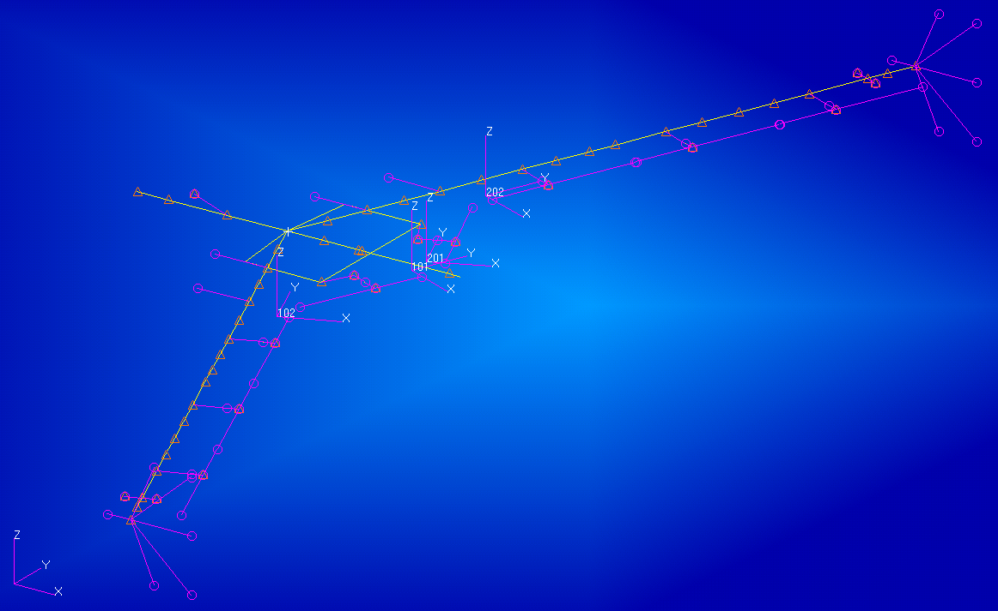
mAEWing1 FEM v2
Updated mAEWing1 Finite Element Model (FEM) version 2.0

Slide 3
mAEWing1 FEM v2
Mass Properties
Modes and Natural frequency (Hz)

Slide 4
Test EI and GJ
Test EI and GJ of complete wing, received July 17
The first 6 elastic mode frequencies (Hz) for rigid wing (w/o foam cuts)
The first 6 elastic mode frequencies (Hz) for flexible wing (w/ foam cuts)

Slide 5
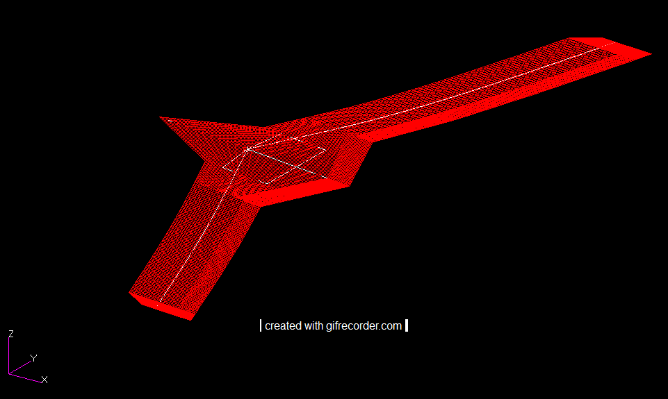
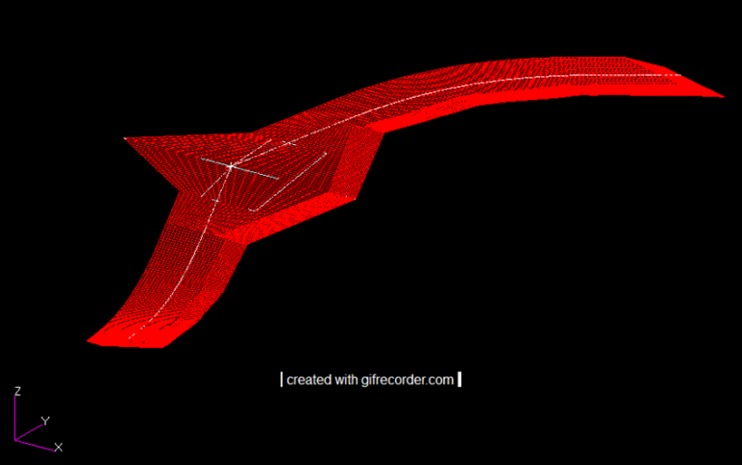
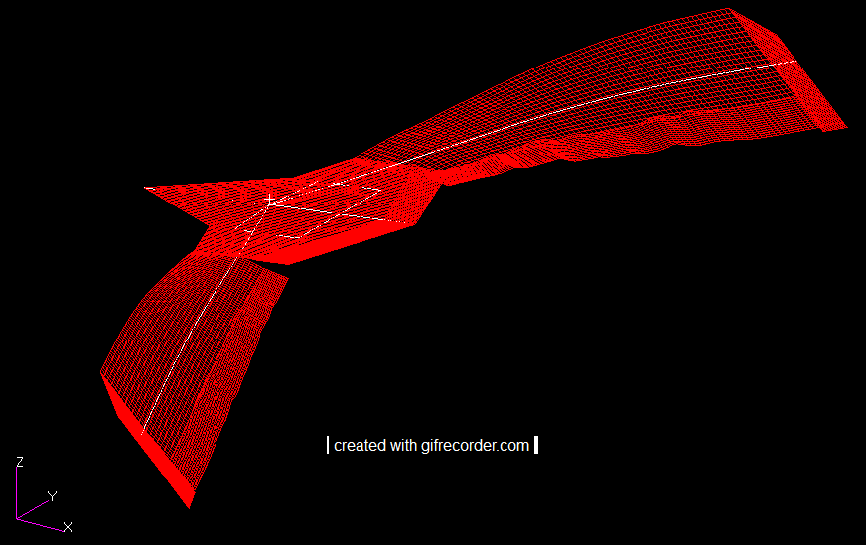
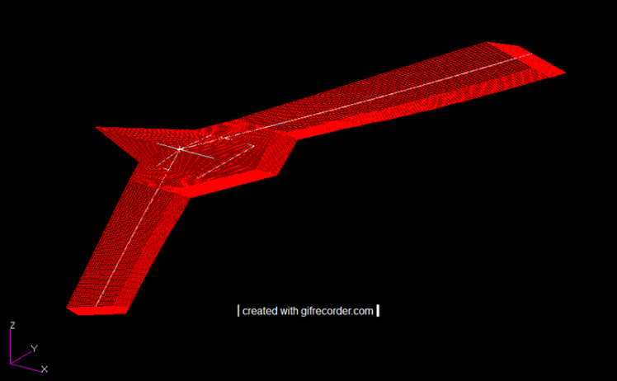
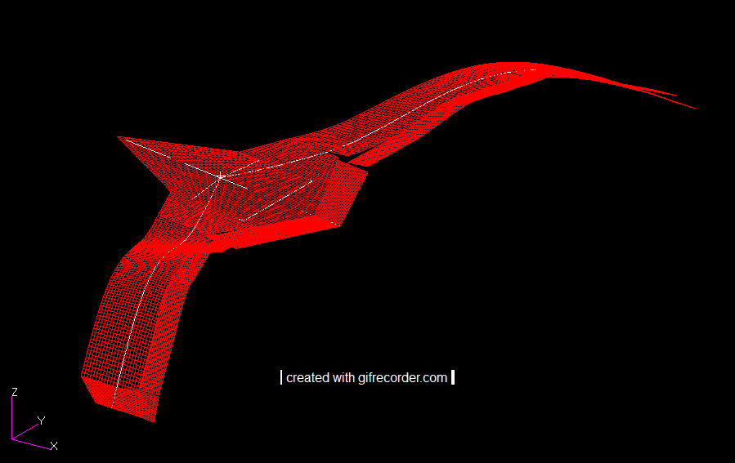
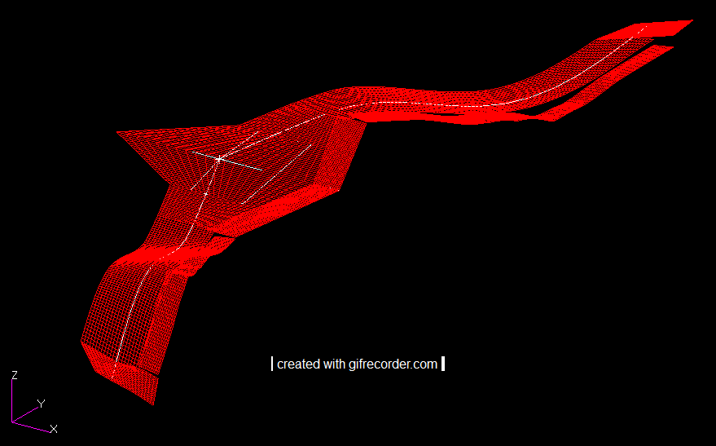
Rigid wing mode shapes
1st SB
6.62 Hz
1st ASB
9.35 Hz
1st ST
17.25 Hz
1st AST
16.16 Hz
2nd SB
20.15 Hz
2nd ASB
24.14 Hz

Slide 6
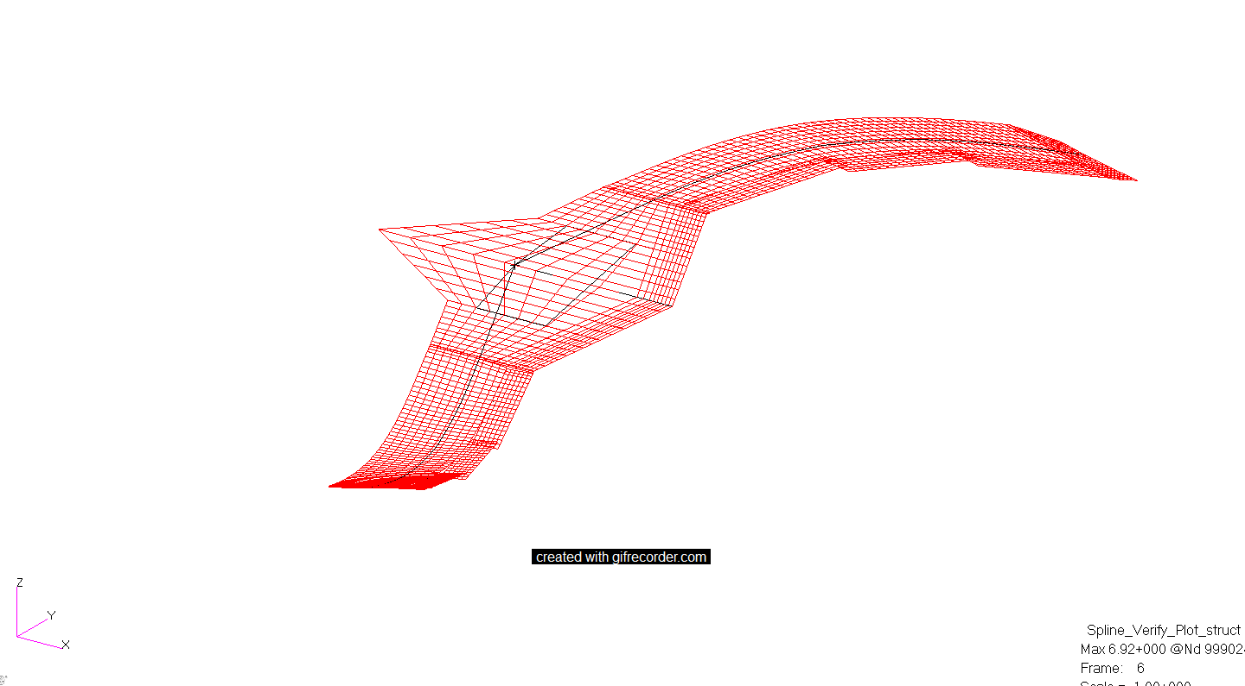
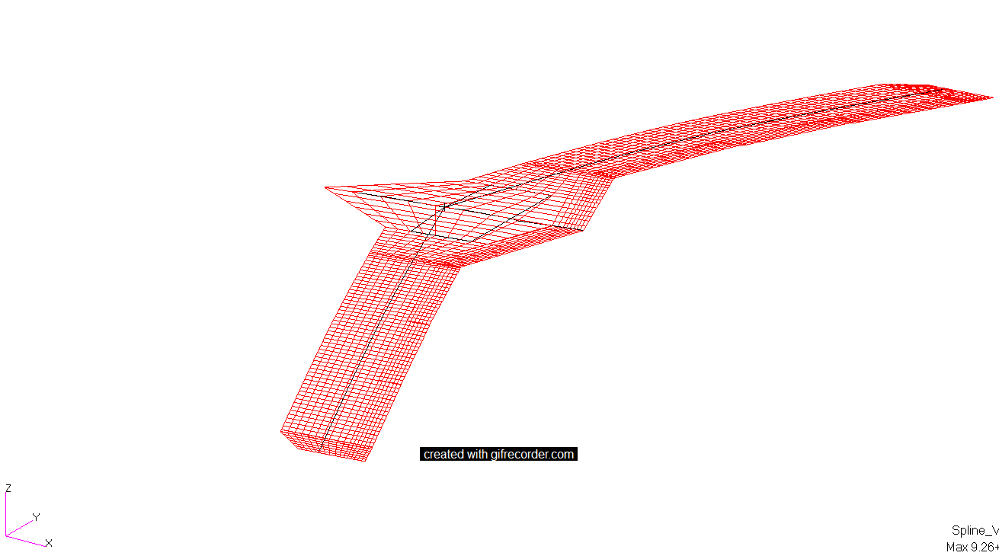
Rigid wing mode shapes
1st SB
6.62 Hz
1st ASB
9.35 Hz

Slide 7
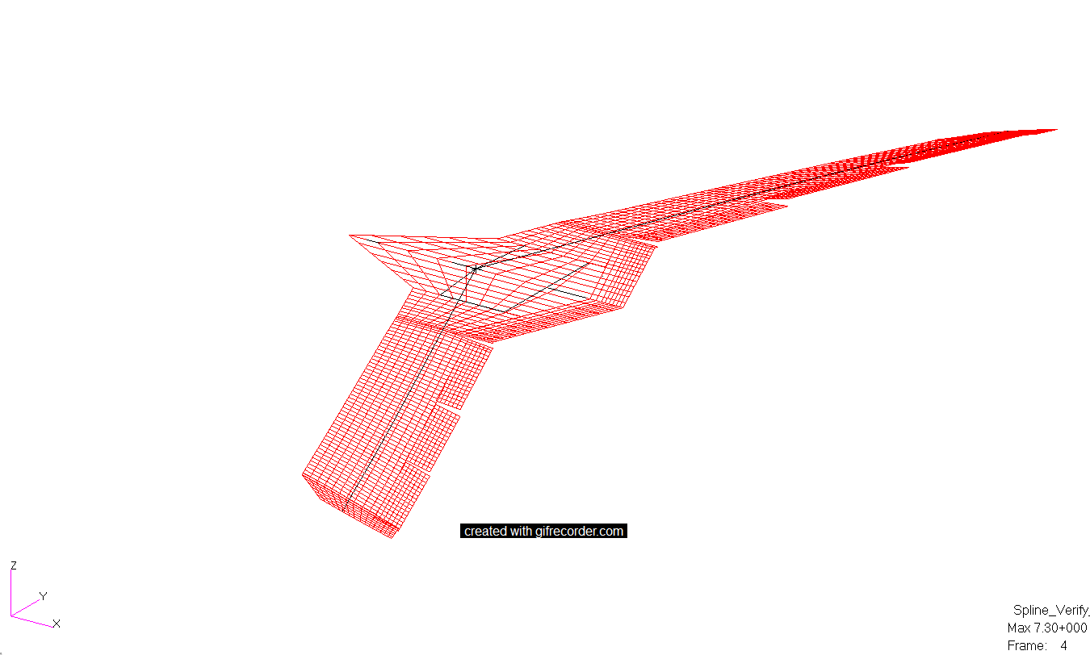
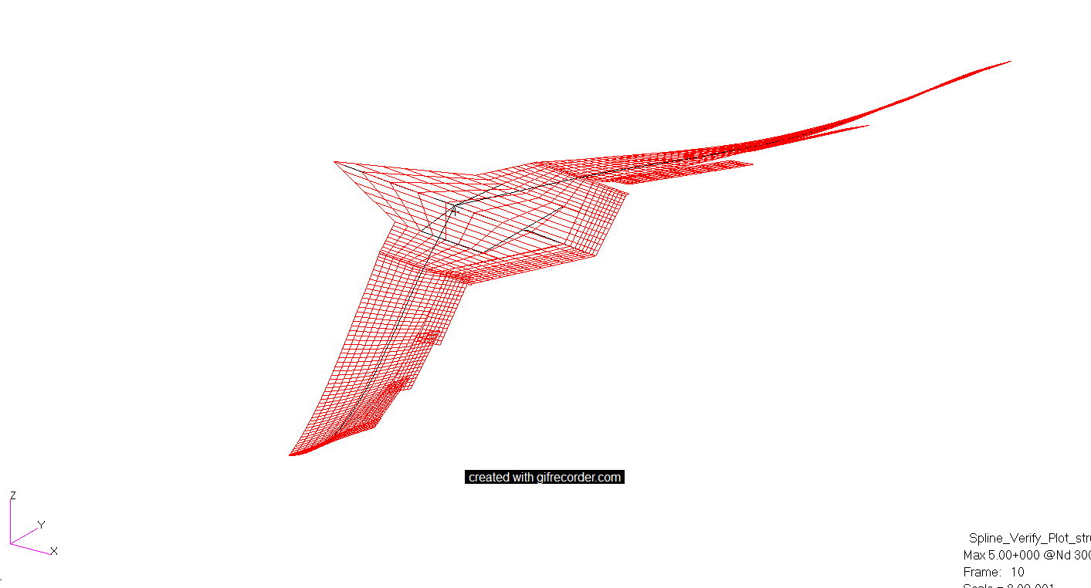
Rigid wing mode shapes
1st ST
17.25 Hz
1st AST
16.16 Hz

Slide 8
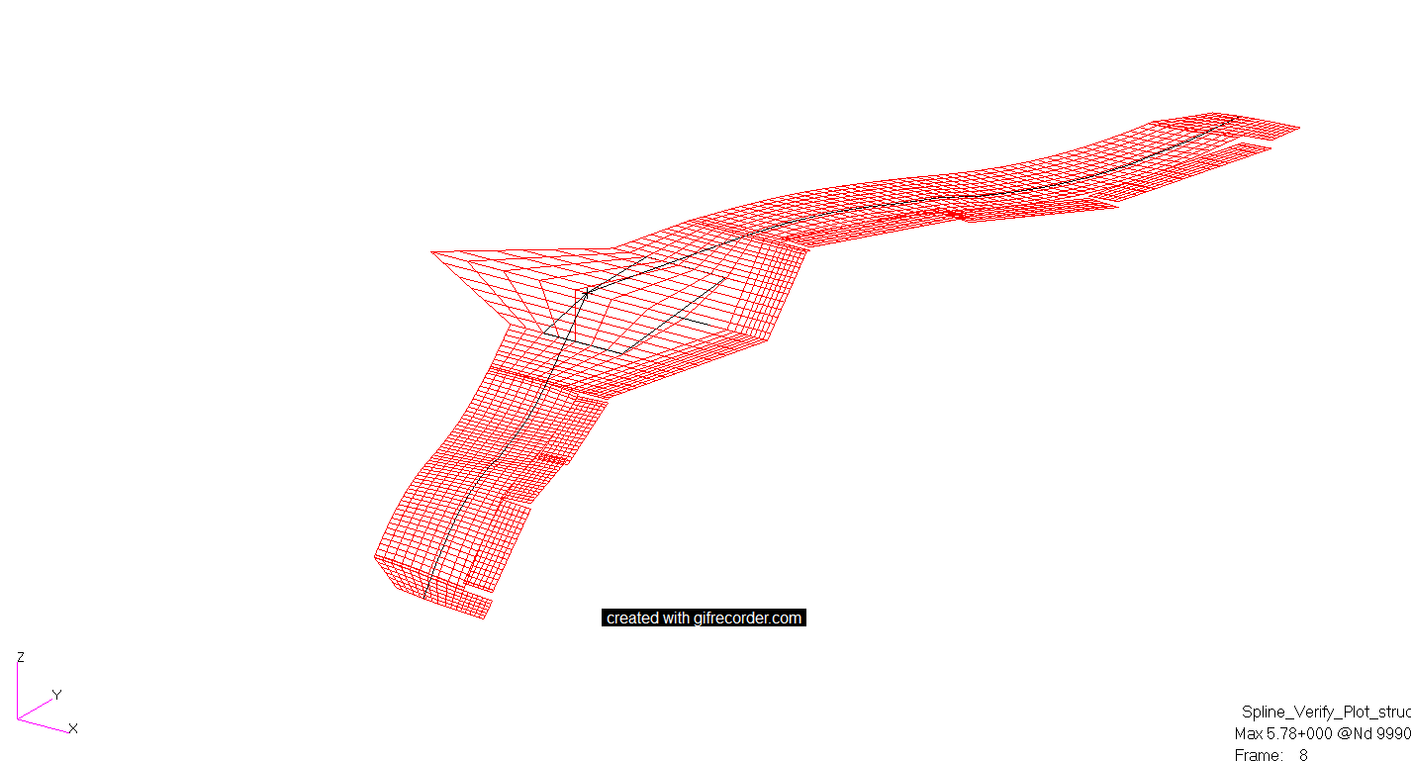
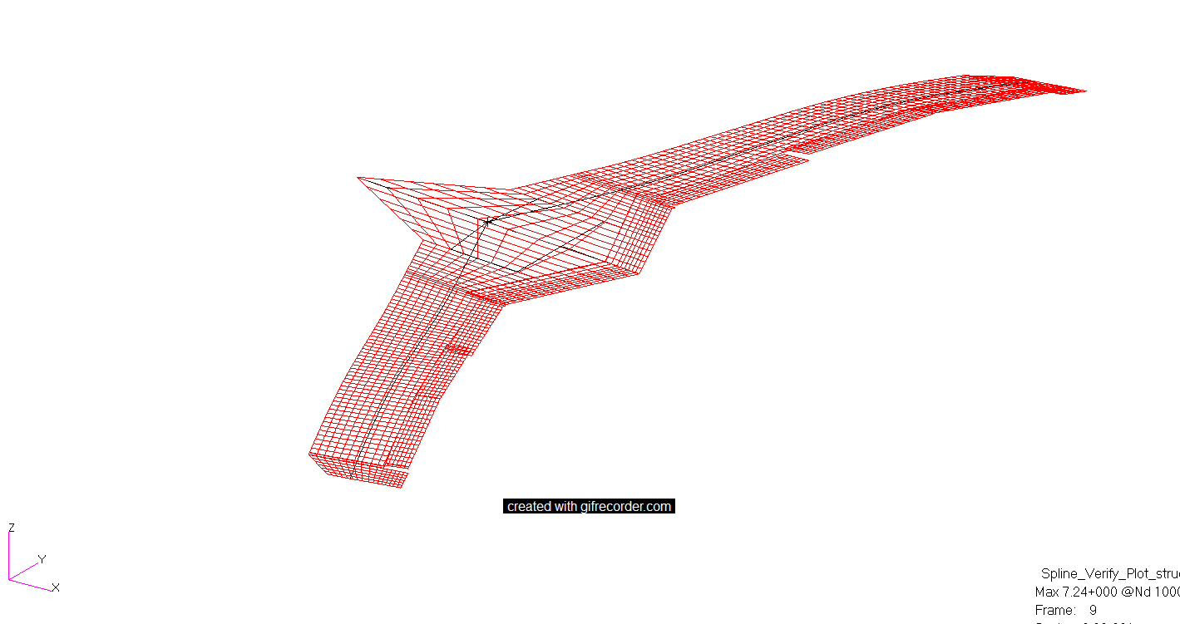
Rigid wing mode shapes
2nd SB
20.15 Hz
2nd ASB
24.14 Hz

Slide 9
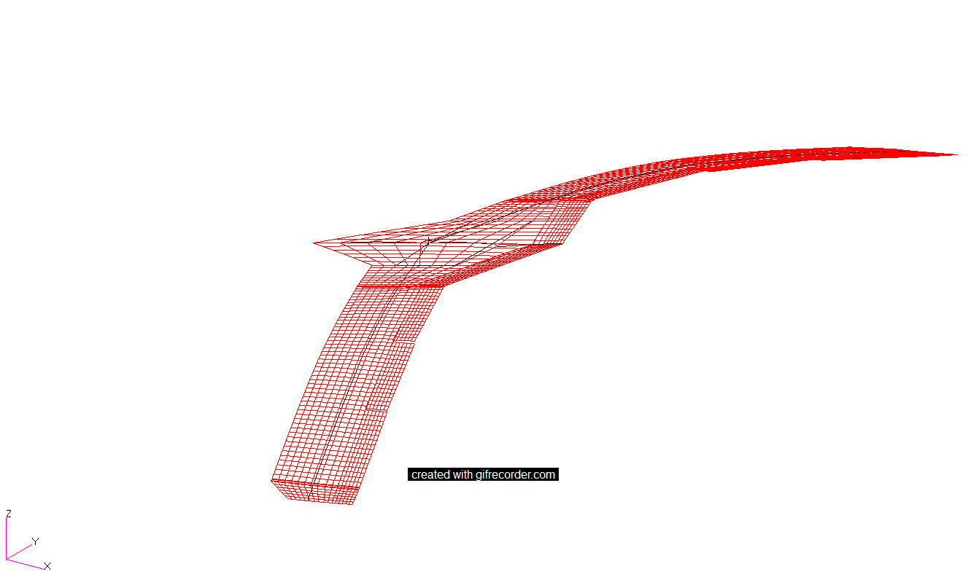
Flexible wing mode shapes, 7
1st SB
4.89 Hz

Slide 10
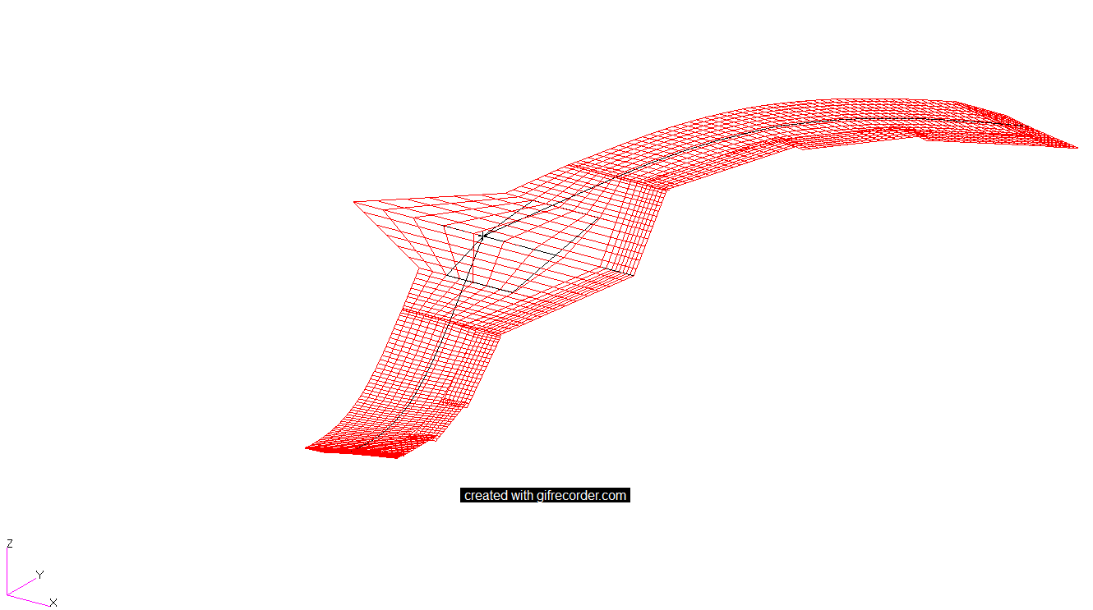
Flexible wing mode shapes, 8
1st ASB
6.85 Hz

Slide 11
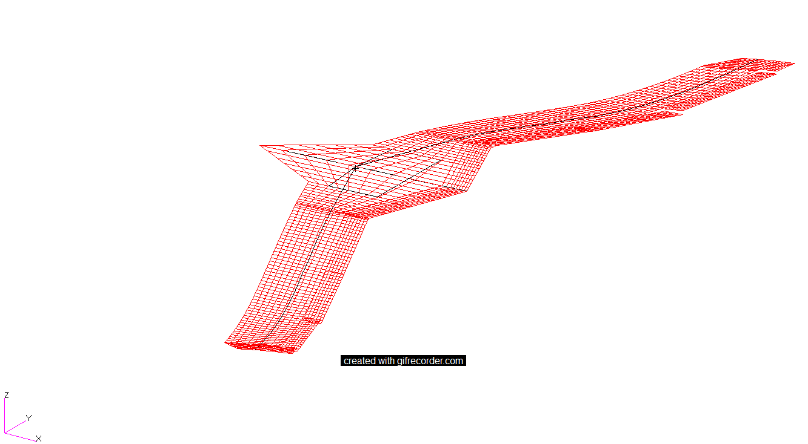
Flexible wing mode shapes, 9
2nd SB
14.08 Hz

Slide 12
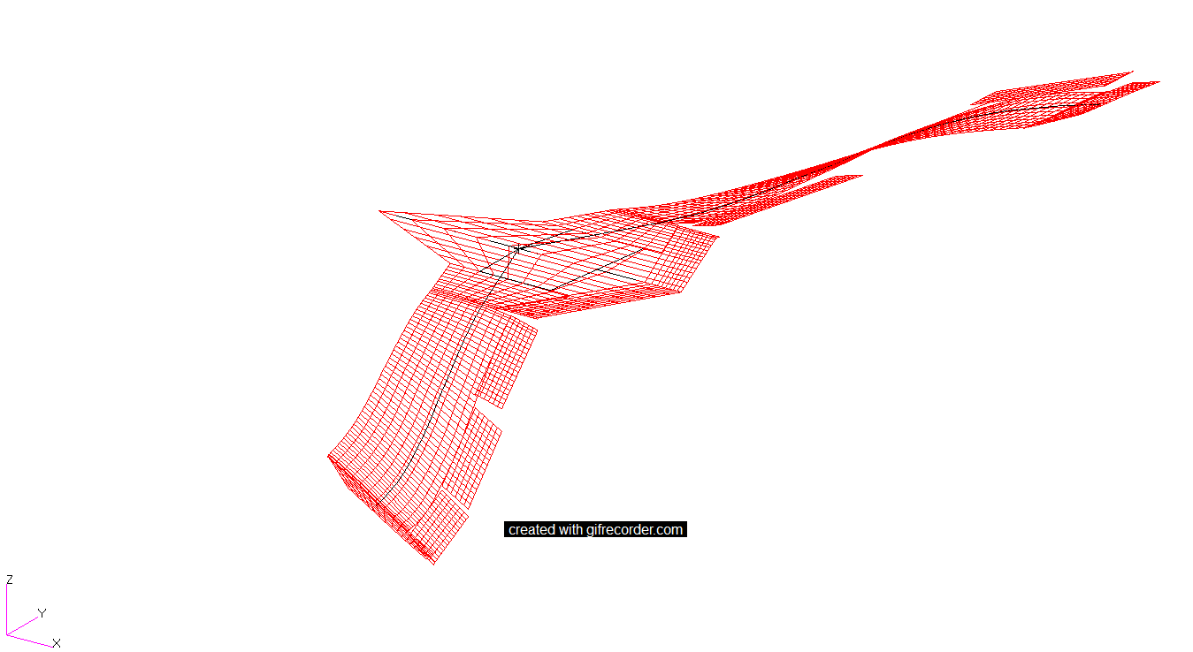
Flexible wing mode shapes, 10
AST/ASB Coupling
16.19 Hz

Slide 13
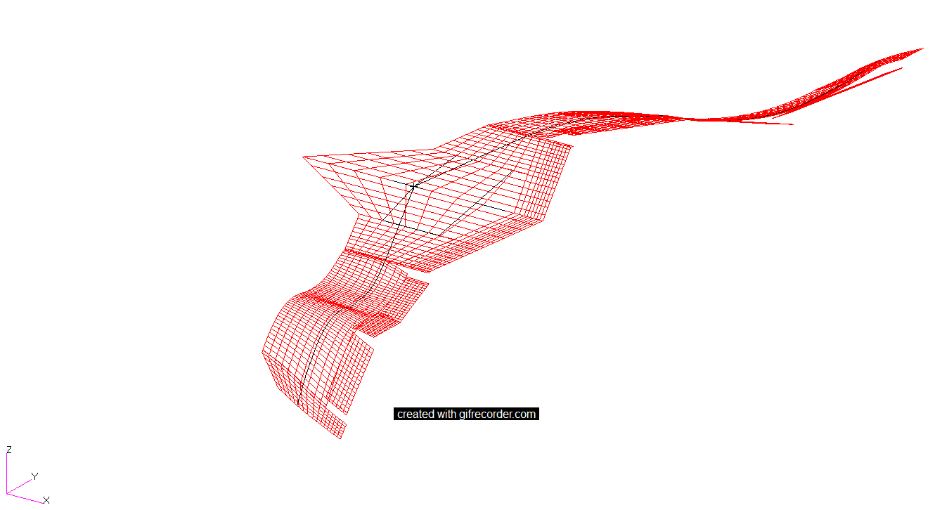
Flexible wing mode shapes, 11
2nd ASB
18.00 Hz

Slide 14
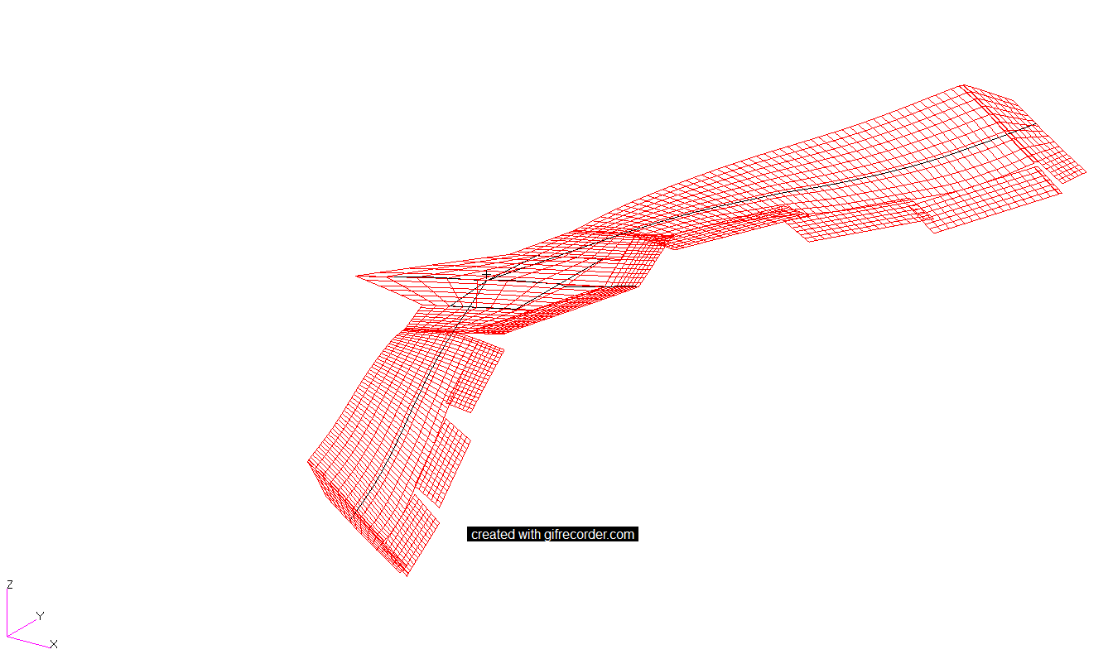
Flexible wing mode shapes, 12
1st ST
18.53 Hz

Slide 15
Design parameters
Geometry | Values
Span | 169.06 in
Reference Chord | 21.25 in
Area | 3386.29 in²
Coefficient Input | Values
Design Lift Coefficient | 0.0477
Design Moment Coefficient | 0.00
Center of Pressure Location | 0.25c
C.G. Position | 32.53 in
Panel No. | No. of Vortices on each panel
1 | 10
2 | 10
3 | 60
4 | 6
5 | 6
6 | 6
Note: The mAEWing2 is divided into 6 panels.
Flight Conditions | Values
Altitude (ft.) | 1000
Velocity (ft/s) | 122.4 (M=.11)
Density (slugs/ft³) | 0.002309

Slide 16
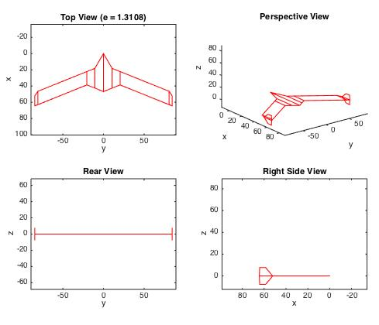
mAEWing2 Lifting surface

Slide 17
Minimal Induced Drag
Output | Values
Actual Lift Coefficient | 0.0477
Actual Moment Coefficient | 0.00
Induced Drag Coefficient | 0.00007
Span Efficiency Factor | 1.31078
Lift | Induced Drag
20 lbs. | 0.02935 lbs.
Note: Here span load is calculated on the points where vortices are located. Since the total number of vortices are 98. So, it is calculated at 98 points where vortices are located.

Slide 18
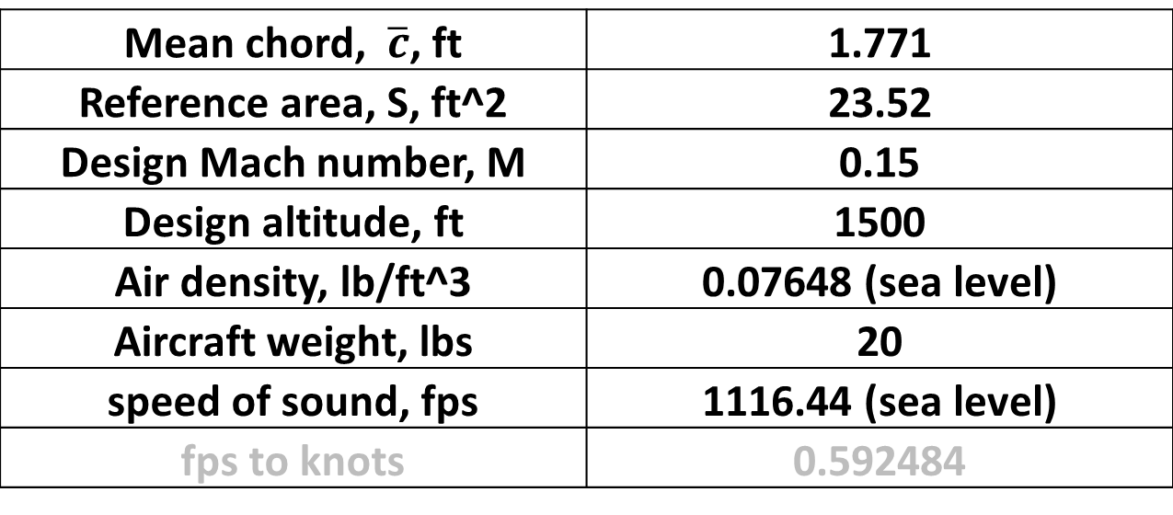
mAEWing2
Preliminary Geometry configuration of mAEWing2 – 14ft span
Mean chord, $\overline{c}$, ft | 1.771
Reference area, S, ft^2 | 23.52
Design Mach number, M | 0.15
Design altitude, ft | 1500
Air density, lb/ft^3 | 0.07648 (sea level)
Aircraft weight, lbs | 20
speed of sound, fps | 1116.44 (sea level)
fps to knots | 0.592484

Slide 19
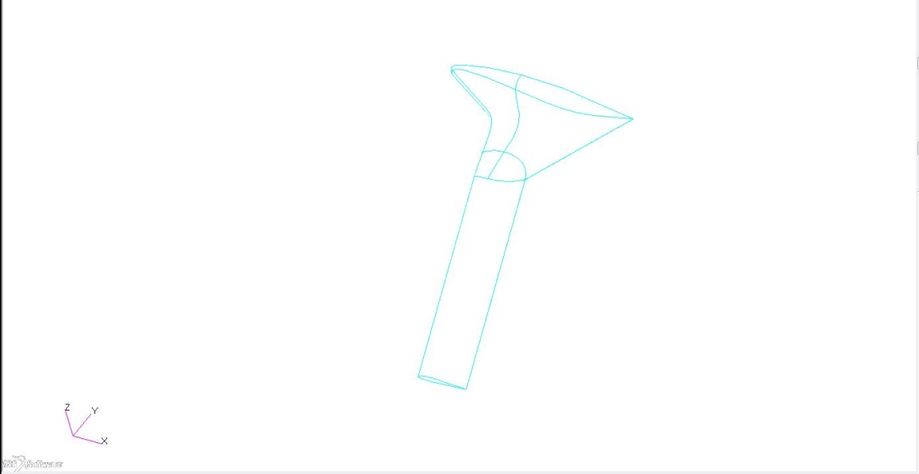
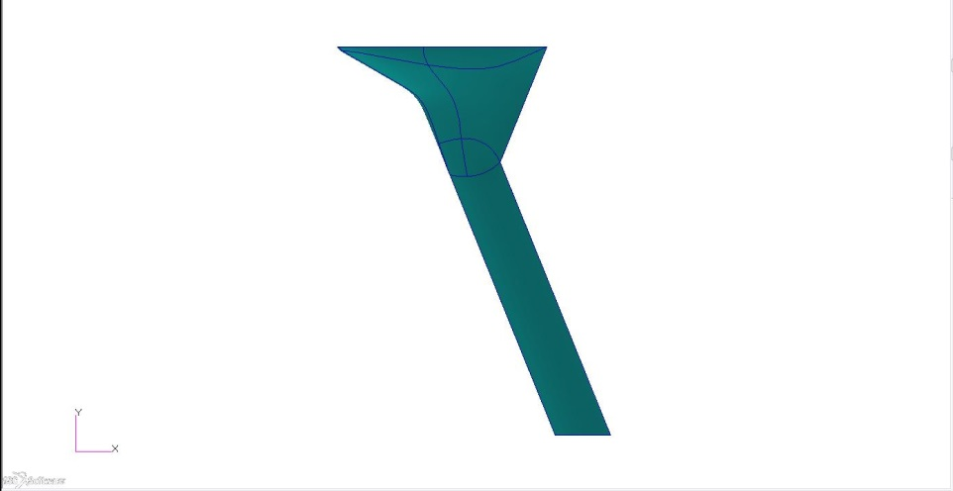
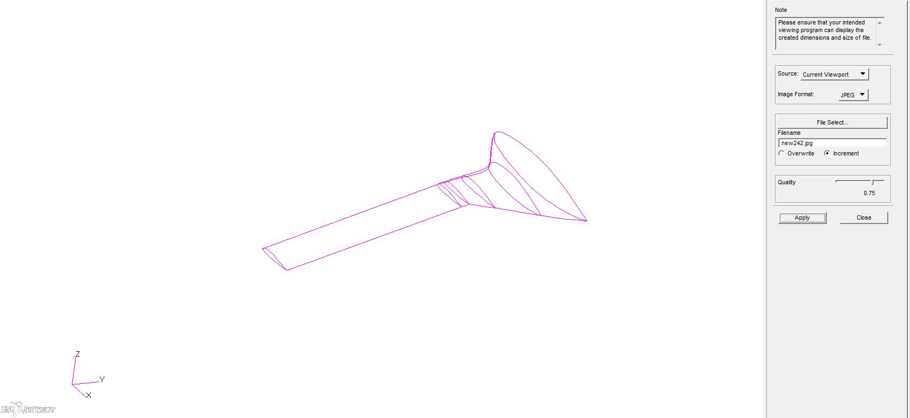
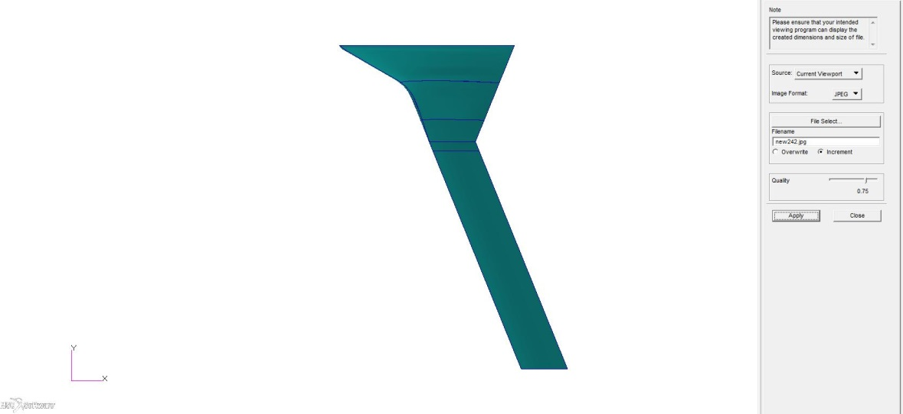
Geometry mAEWing2
mAEWing2 base geometry
14 FT
Scaled 14ft span OML
Adding leading spar and rear spar by scaling the locations in X56A by 50%.

Slide 20
Next work
Waiting for GVT mode test data to update mAEWing1 FEM to match mode shapes and mode frequencies
Integrate mAEWing2 geometry into EBF3GLWingOpt for preliminary mAEWing2 design
Need to know material properties; equivalent isotropic/orthotropic material used?
Design loads? (+3.8g/-1g)+1.5 factor of safety?
Integrate wing shape design. Flap deflection ranges?

Slide 21
Backup slides

Slide 22
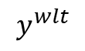
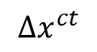
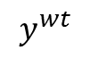
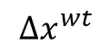
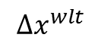
Calculate Ixx and Iyy for wing
Y
X
Center Body CG
23.23’’
18.55’’
Left wing CG
28.27’’
Winglet CG
42.45’’
$$Δx^{ct}$$
mAEWing1 CG
$$Δx^{wt}$$
31.47’’
$$y^{wt}$$
$$Δx^{wlt}$$
60.25’’
$$y^{wlt}$$
mAEWing1
CB
Wing
Winglet
Pitch
$$I_{yy}^{t}=\left[m^{c}{\left(Δx^{ct}\right)}^{2}+I_{yy}^{cb}\right]+ 2\left[m^{w}{\left(Δx^{wt}\right)}^{2}+I_{yy}^{w}\right] + 2m^{wl}{\left(Δx^{wlt}\right)}^{2}$$
327.48 lb-in^2
Roll
$$I_{xx}^{t}= I_{xx}^{cb} + 2\left[m^{w}{\left(y^{wt}\right)}^{2}+I_{xx}^{w} \right] + 2m^{wl}{\left(y^{wlt}\right)}^{2}$$
1393.95 lb-in^2

Slide 23
Updated mAEWing1 Wing

Slide 24
Updated mAEWing1 Centerbody

Slide 25
mAEWing2 Design
Structural design
Using EBF3GLWingOpt
SpaRibs
Move optimization part to NASTRAN sol 200
Wing shape design
Trailing/Leading flaps change the lift distribution for minimal induced drag
Conformal control surface

Slide 26
Updated FEM Summary
Updated mAEWing1 FEM v2.0 has the mass properties close with test data in both centerbody, wing and full model except 2.36% error in cg of full model. (probably error in the test wing error, or probably mass distribution has some changes for installed full model )
Most data including, geometry dimension for solid spars, wing attach, material density for solid spar, mass of servos, flaps, winglets, accelerometers are obtained from CAD model and test data. Point masses for wing form foam and cover fabric, location for most point mass elements are obtained from structural optimization
Update the beam properties EI and GJ based on test data of wing w/ spar#5.
Subject to update to match GVT mode frequencies and mode shapes

Slide 27
